Slide 1
Using random models in derivative free optimization
Katya Scheinberg
Lehigh University
(mainly based on work with A. Bandeira and L.N. Vicente and also with A.R. Conn, Ph.Toint and C. Cartis )

Slide 2
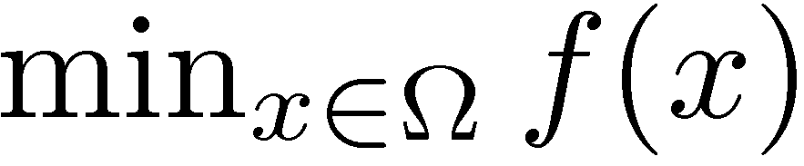
Derivative free optimization
Unconstrained optimization problem
Function f is computed by a black box, no derivative information is available.
Numerical noise is often present, but we do not account for it in this talk!
f 2 C¹ or C² and is deterministic.
May be expensive to compute.

Slide 3
Black box function evaluation
x=(x₁,x₂,x₃,…,x_{n})
All we can do is “sample” the function values at some sample points
v=f(x₁,…,x_{n})
v

Slide 4
Sampling the black box function
Sample points
How to choose and to use the sample points and the functions values defines different DFO methods

Slide 5
Outline
Review with illustrations of existing methods as motivation for using models.
Polynomial interpolation models and motivation for models based on random sample sets.
Structure recovery using random sample sets and compressed sensing in DFO.
Algorithms using random models and conditions on these models.
Convergence theory for TR framework based on random models.

Slide 6
Algorithms

Slide 7
Nelder-Mead method (1965)

Slide 8
Nelder-Mead method (1965)

Slide 9
Nelder-Mead method (1965)

Slide 10
Nelder-Mead method (1965)

Slide 11
Nelder-Mead method (1965)

Slide 12
Nelder-Mead method (1965)
The simplex changes shape during the algorithm to adapt to curvature. But the shape can deteriorate and NM gets stuck

Slide 13

Nelder Mead on Rosenbrock
Surprisingly good, but essentially a heuristic

Slide 14
Direct Search methods (early 1990s)
Torczon, Dennis, Audet, Vicente, Luizzi, many others

Slide 15
Direct Search methods
Torczon, Dennis, Audet, Vicente, Luizzi, many others

Slide 16
Direct Search methods
Torczon, Dennis, Audet, Vicente, Luizzi, many others

Slide 17
Direct Search method
Torczon, Dennis, Audet, Vicente, Luizzi, many others

Slide 18
Direct Search method
Torczon, Dennis, Audet, Vicente, Luizzi, many others

Slide 19
Direct Search method
Torczon, Dennis, Audet, Vicente, Luizzi, many others

Slide 20
Direct Search method
Torczon, Dennis, Audet, Vicente, Luizzi, many others

Slide 21
Direct Search method
Fixed pattern, never deteriorates: theoretically convergent, but slow

Slide 22
Compass Search on Rosenbrock
Very slow because of badly aligned axis directions

Slide 23
Random directions on Rosenbrock
Polyak, Yuditski, Nesterov, Lan, Nemirovski, Audet & Dennis, etc
Better progress, but very sensitive to step size choices

Slide 24
Model based trust region methods
Powell, Conn, S. Toint, Vicente, Wild, etc.

Slide 25
Model based trust region methods
Powell, Conn, S. Toint, Vicente, Wild, etc.

Slide 26
Model based trust region methods
Powell, Conn, S. Toint, Vicente, Wild, etc.

Slide 27
Model Based trust region methods
Exploits curvature, flexible efficient steps, uses second order models.

Slide 28
Second order model based TR method on Rosenbrock

Slide 29
Moral:
Building and using models is a good idea.
Randomness may offer speed up.
Can we combine randomization and models successfully and what would we gain?

Slide 30
Polynomial models

Slide 31
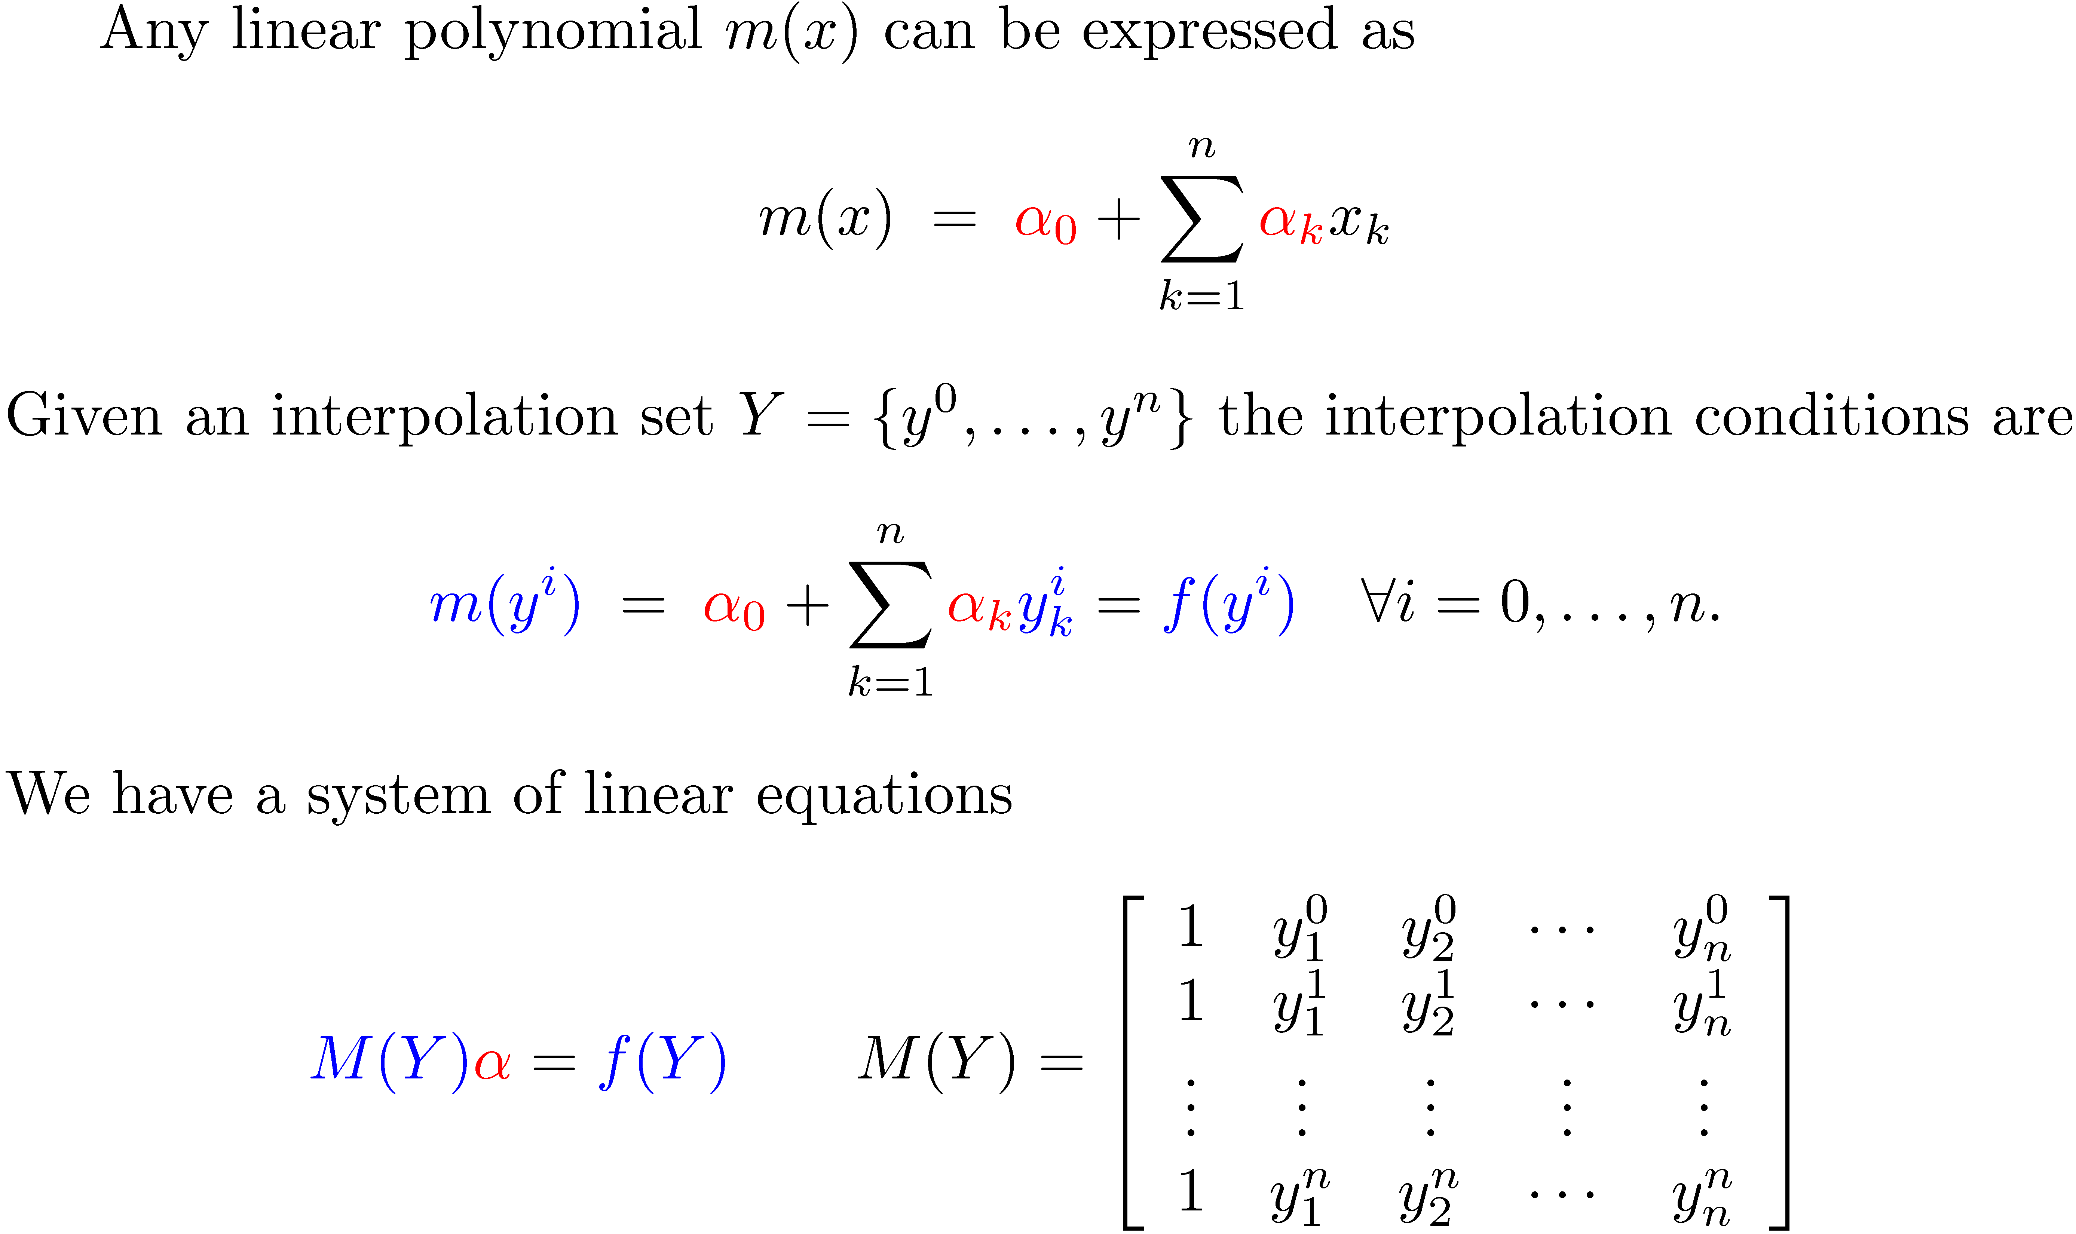
Linear Interpolation

Slide 32
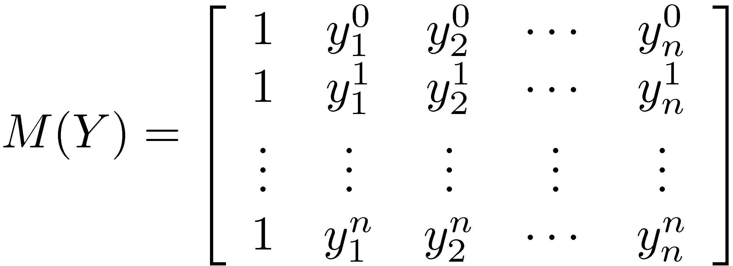
Good vs. bad linear Interpolation
If
is nonsingular
then linear model exists for any f(x)
Better conditioned M => better models

Slide 33
Examples of sample sets for linear interpolation
Badly poised set
Finite difference sample set
Random sample set

Slide 34
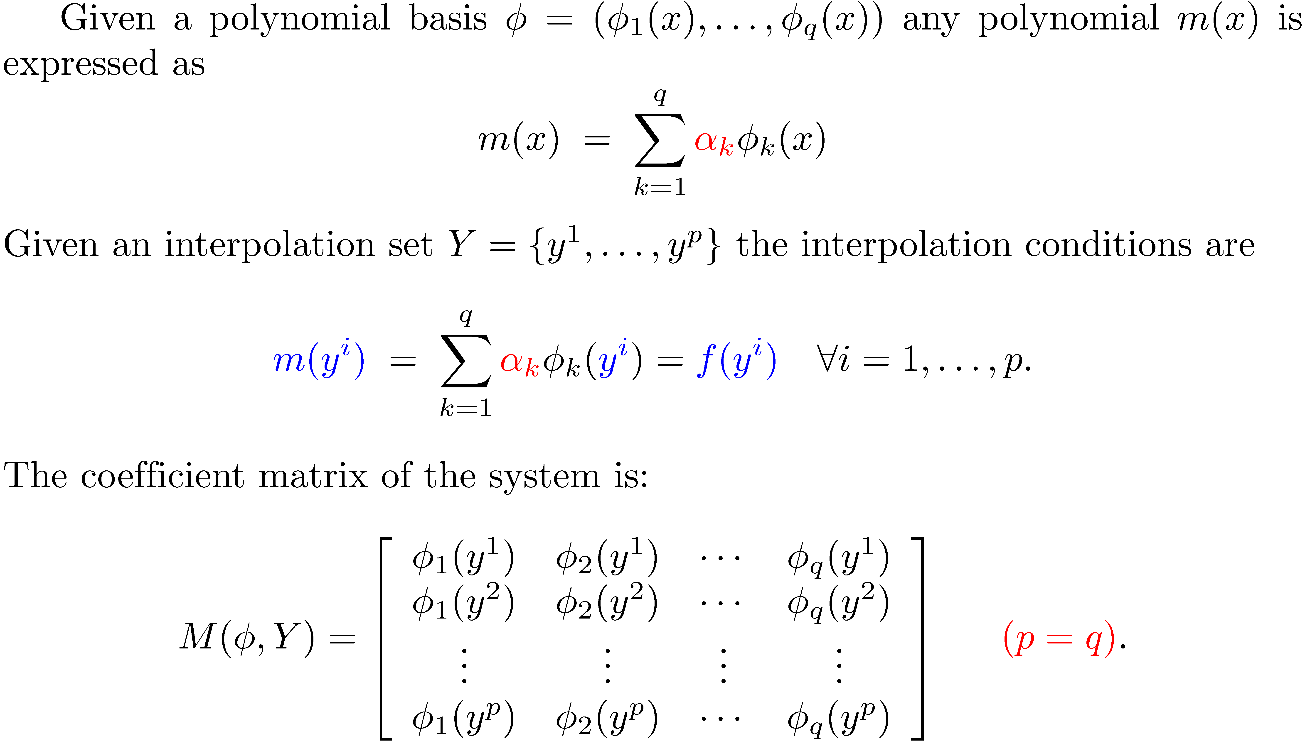
Polynomial Interpolation

Slide 35
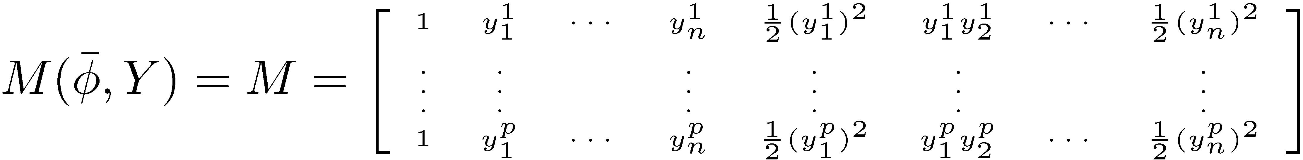
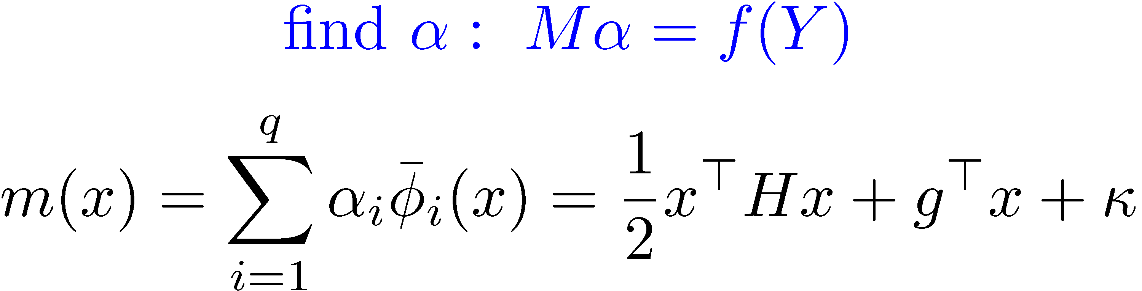
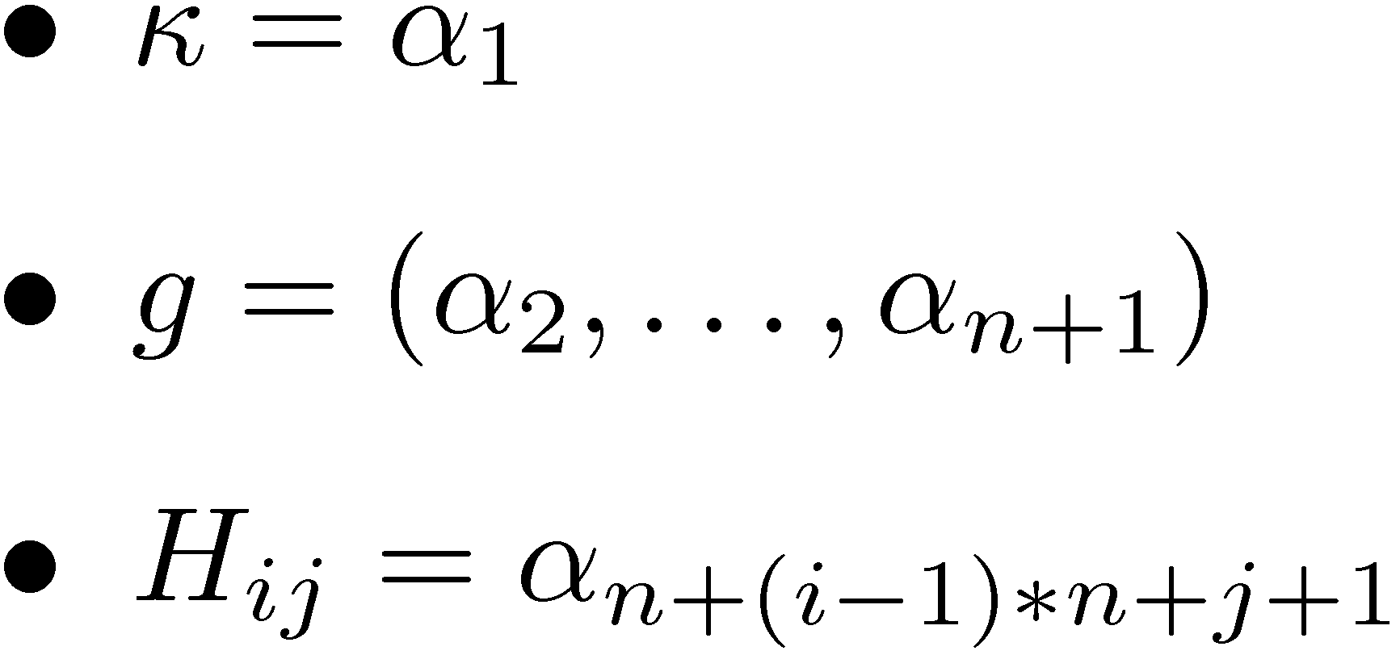
Specifically for quadratic interpolation
Interpolation model:

Slide 36
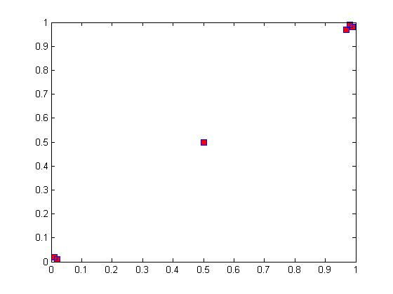
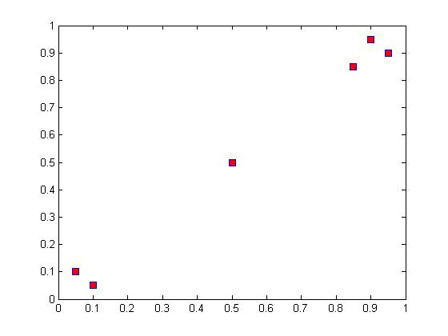
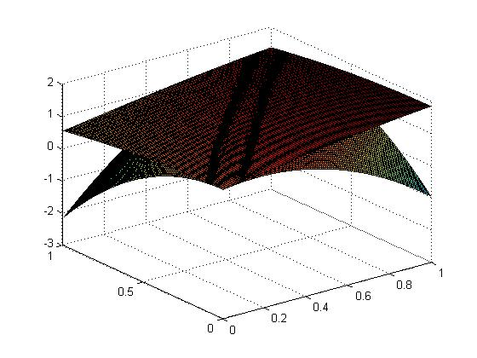
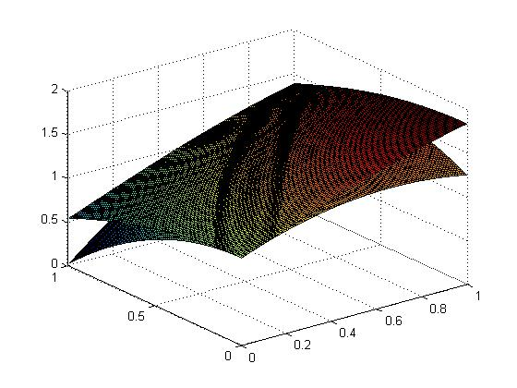
Sample sets and models for f(x)=cos(x)+sin(y)

Slide 37
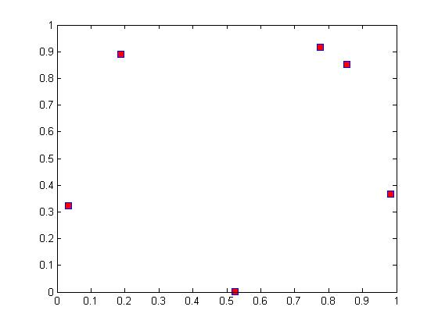
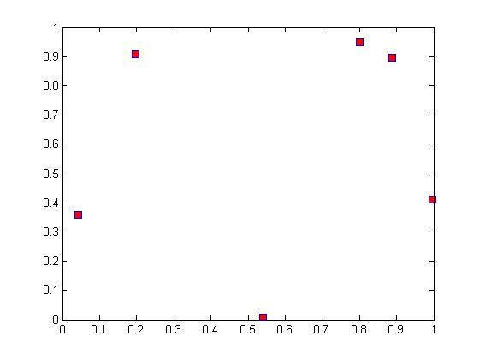
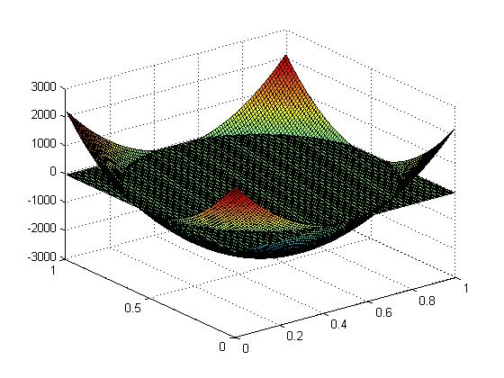
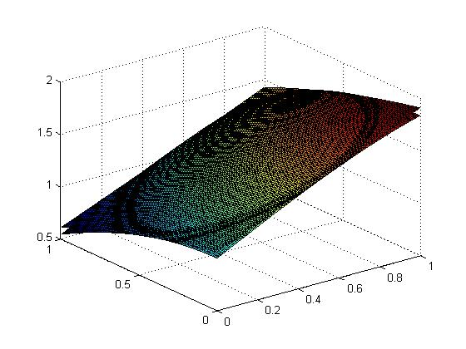
Sample sets and models for f(x)=cos(x)+sin(y)

Slide 38
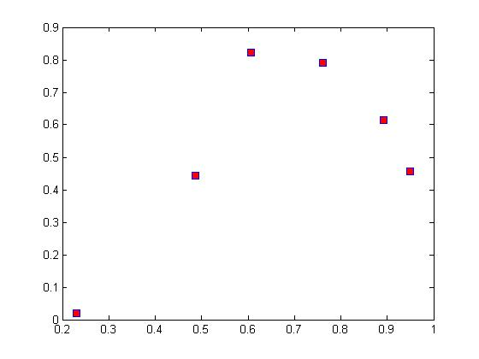
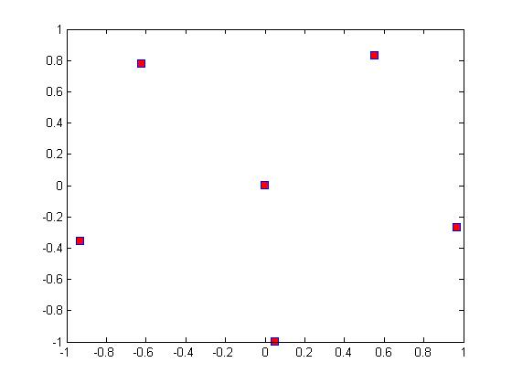
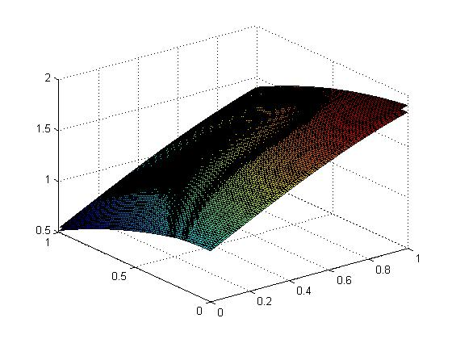
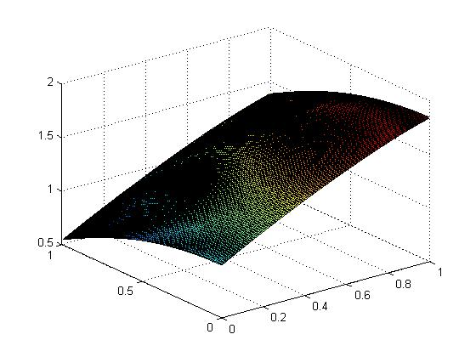
Sample sets and models for f(x)=cos(x)+sin(y)

Slide 39
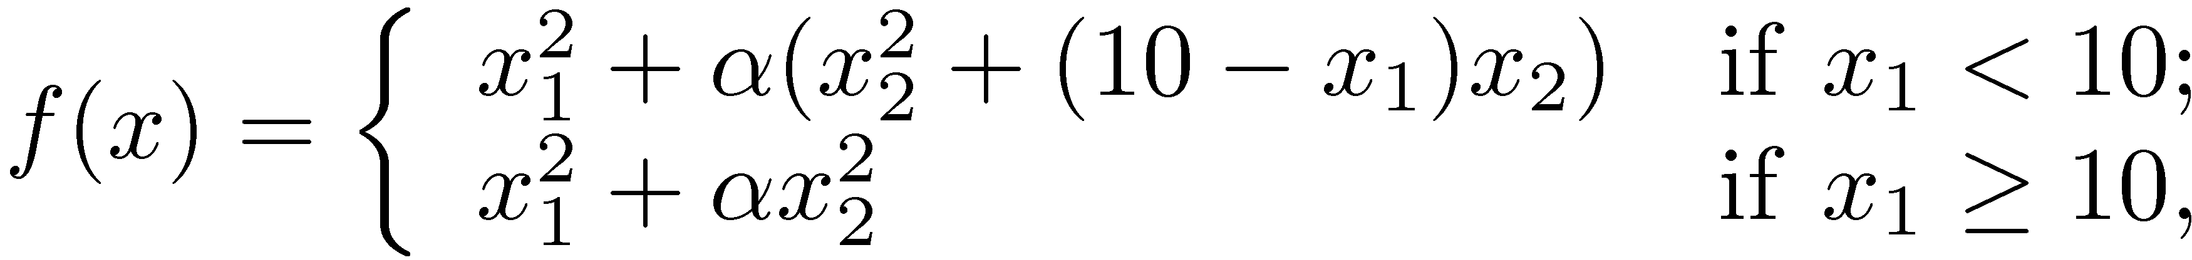
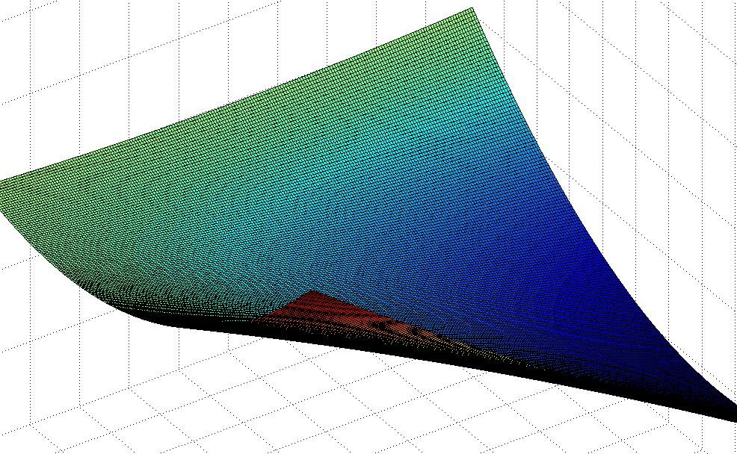
Example that shows that we need to maintain the quality of the sample set

Slide 42
Observations:
Building and maintaining good models is needed.
But it requires computational and implementation effort and many function evaluations.
Random sample sets usually produce good models, the only effort required is computing the function values.
This can be done in parallel and random sample sets can produce good models with fewer points.
How?

Slide 43
“sparse” black box optimization
x=(x₁,x₂,x₃,…,x_{n})
v=f(x_{S})
S½{1..n}
v

Slide 44
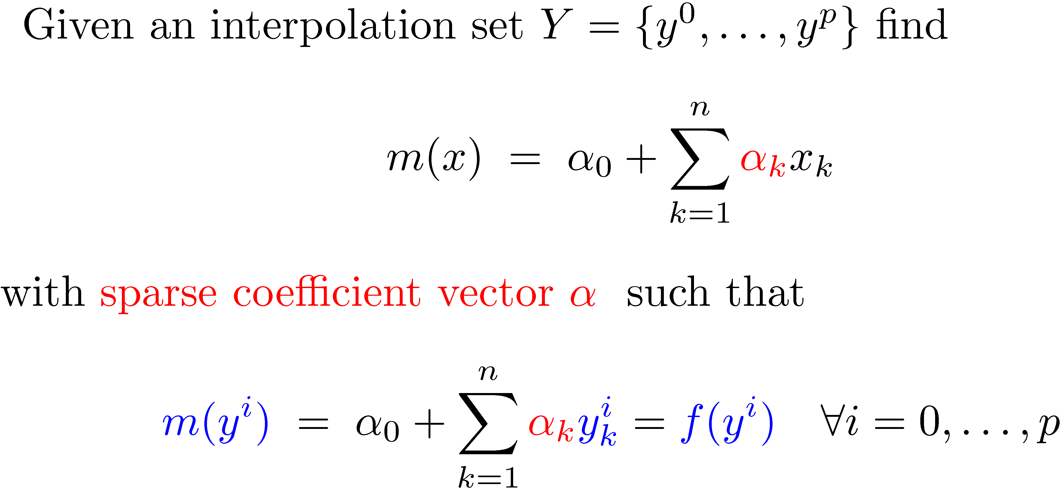
Sparse linear Interpolation

Slide 45
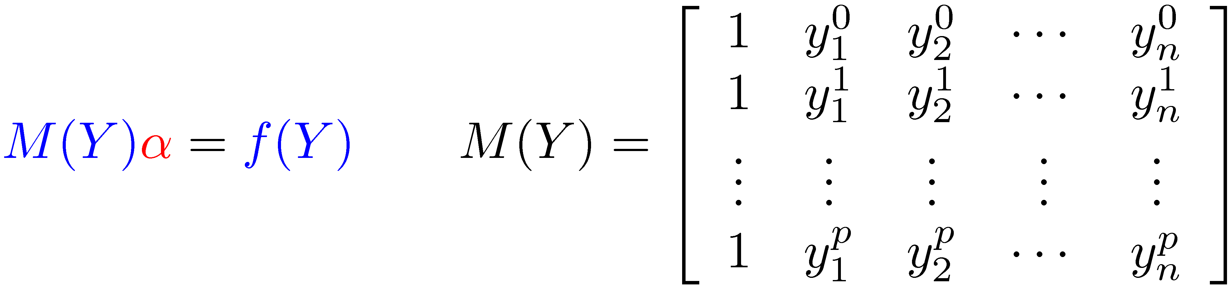
Sparse linear Interpolation
We have an (underdetermined) system of
linear equations with a sparse solution
Can we find correct sparse ® using less than n+1 sample points in Y?

Slide 46

Using celebrated compressed sensing results (Candes&Tao, Donoho, etc)
By solving
Whenever
has RIP

Slide 47
Using celebrated compressed sensing results and random matrix theory (Candes&Tao, Donoho, Rauhut, etc)
Does
have RIP?
Yes, with high prob., when Y is random and p=O(|S|log n)
Note: O(|S|log n)<<n

Slide 48
Quadratic interpolation models
Need p=(n+1)(n+2)/2 sample points!!!
Interpolation model:

Slide 49
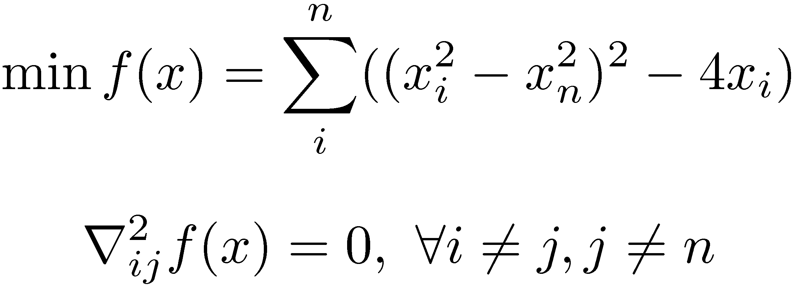
Example of a model with sparse Hessian
Colson, Toint
® has only 2n+n nonzeros
Can we recover the sparse ® using less than O(n) points?

Slide 50
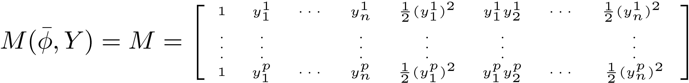
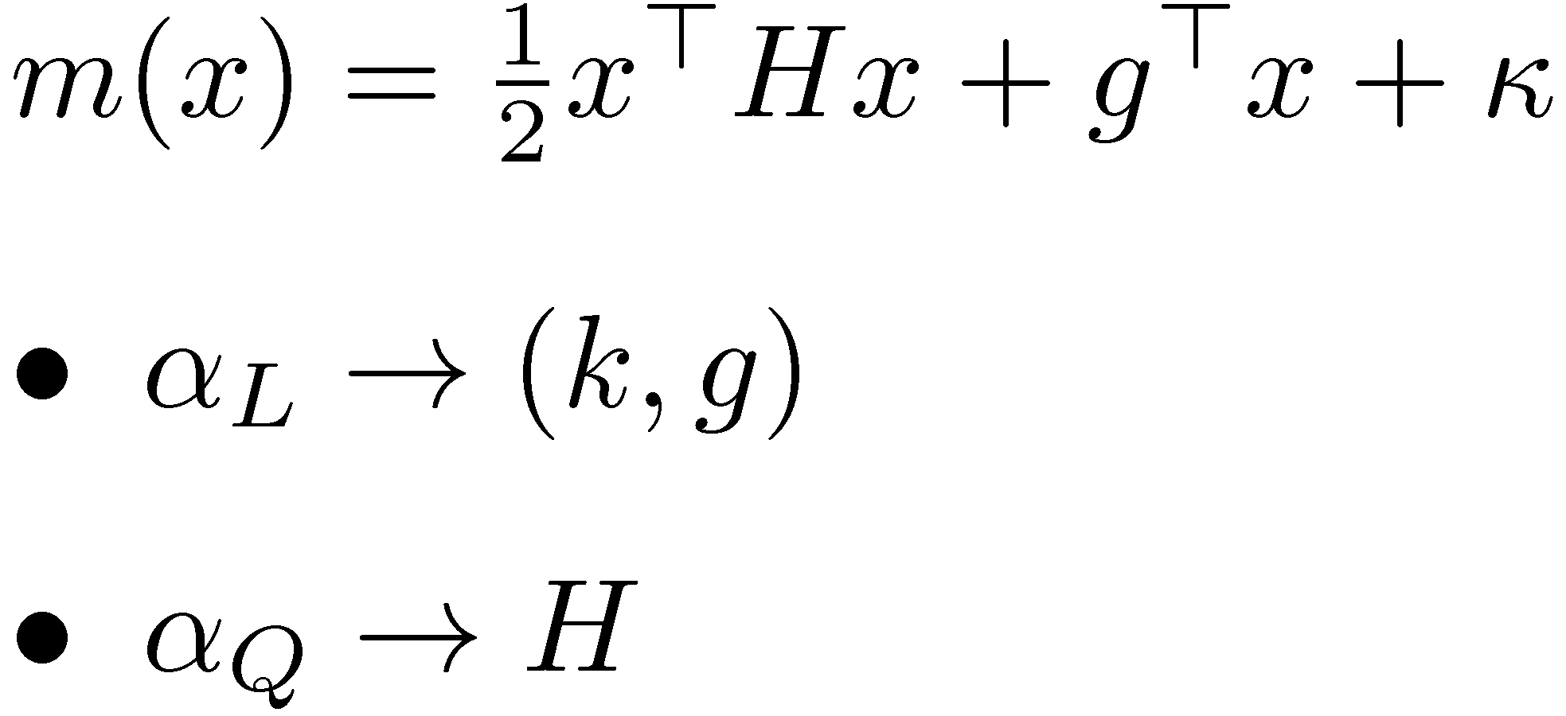
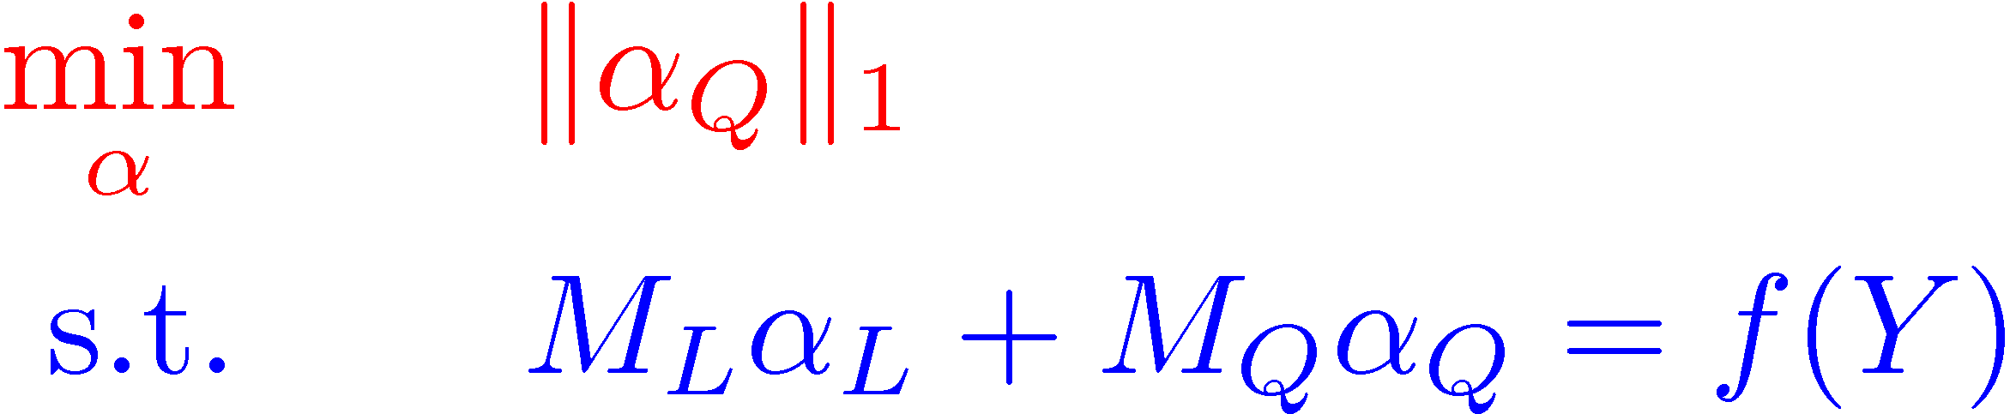
Sparse quadratic interpolation models
M_{L}
M_{Q}
Recover sparse ®

Slide 51
Does RIP hold for this matrix?
M_{L}
M_{Q}

Slide 52
Does RIP hold for this matrix?
M_{L}
M_{Q}
Actually we need RIP for M_{Q} and some other property on M_{L}

Slide 53
Using results from random matrix theory (Rauhut, Bandeira, S. & Vincente)
M_{L}
M_{Q}
Yes, with high probability, when Y is random and p=O((n+s)(log n)⁴)
Note: p=O((n+s)(log n)⁴)<<n² (sometimes)
For more detailed analysis
see Afonso Bandeira’s talk
Tue 15:15 - 16:45, room: H 3503

Slide 54
Model-based method on 2-dimensional Rosenbrock function lifted into 10 dimensional space
Consider f(x₁, x₂, …, x₁₀)=Rosenbrock(x₁, x₂)
To build full quadratic interpolation we need 66 points. We test two methods:
Deterministic model-based TR method: builds a model using whatever points it has on hand up to 66 in the neighborhood of the current iterate, using MFN Hessian models (standard reliable good approach).
Random model based TR method: builds sparse models using 31 randomly sampled points.

Slide 55
Deterministic MFN model based method

Slide 56
Random sparse model based method

Slide 57
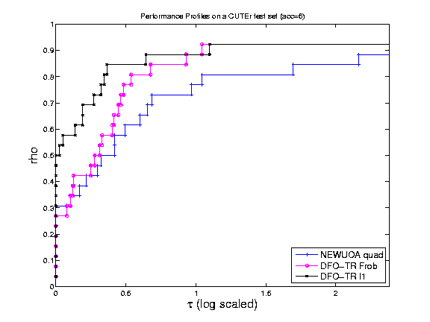
Comparison of sparse vs MFN models (no randomness) within TR on CUTER problems

Slide 58
Algorithms based on random models
We now forget about sample sets and how we build the models.
We focus on properties of the models that are essential for convergence.
Ensure that those properties are satisfied by models we just discussed.

Slide 59
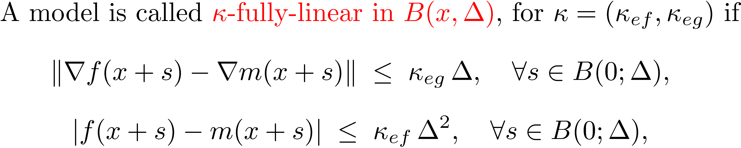
What do we need from a deterministic model for convergence?
We need Taylor-like behavior of first-order models

Slide 60
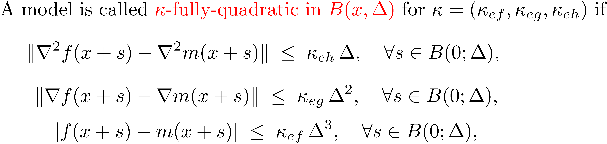
What do we need from a model to explore the curvature?
We may want Taylor-like behavior of second-order models

Slide 61
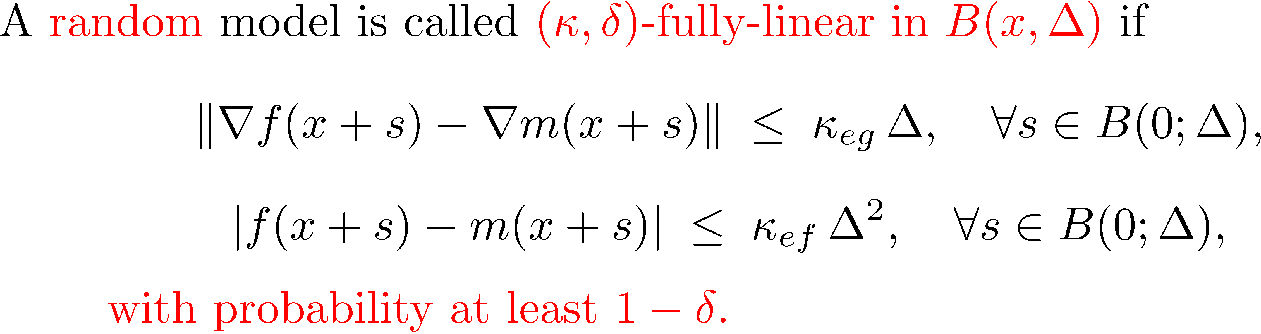
What do we need from a random model for convergence?
We need likely Taylor-like behavior of first-order models

Slide 62
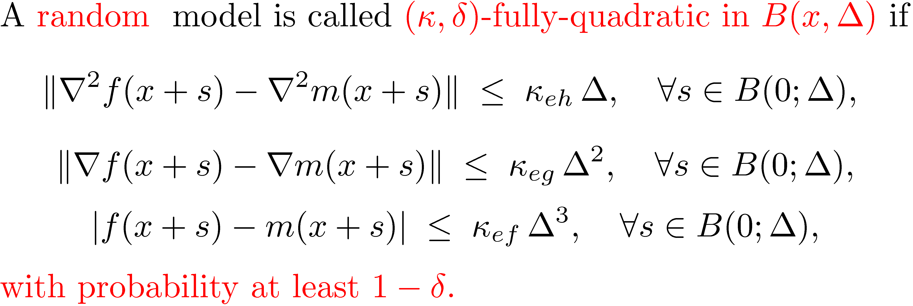
What do we need from a random model to explore curvature?
We need likely Taylor-like behavior of second order models

Slide 63
What random models have such properties?
Linear interpolation and regression models based on random sample sets of n+1 points are (·, ±)-fully-linear.
Quadratic interpolation and regression models based on random sample sets of (n+1)(n+1)/2 points are (·, ±)-fully-quadratic.
Sparse linear interpolation and reg. models based on smaller random sample sets are (·, ±)-fully-linear.
Sparse quadratic interpolation and reg. models based on smaller random sample sets are (·, ±)-fully-quadratic.
Taylor models based on finite difference derivative evaluations with asynchronous faulty parallel function evaluations are (·, ±)-FL or FQ.
Gradient sampling models? Other examples?

Slide 64
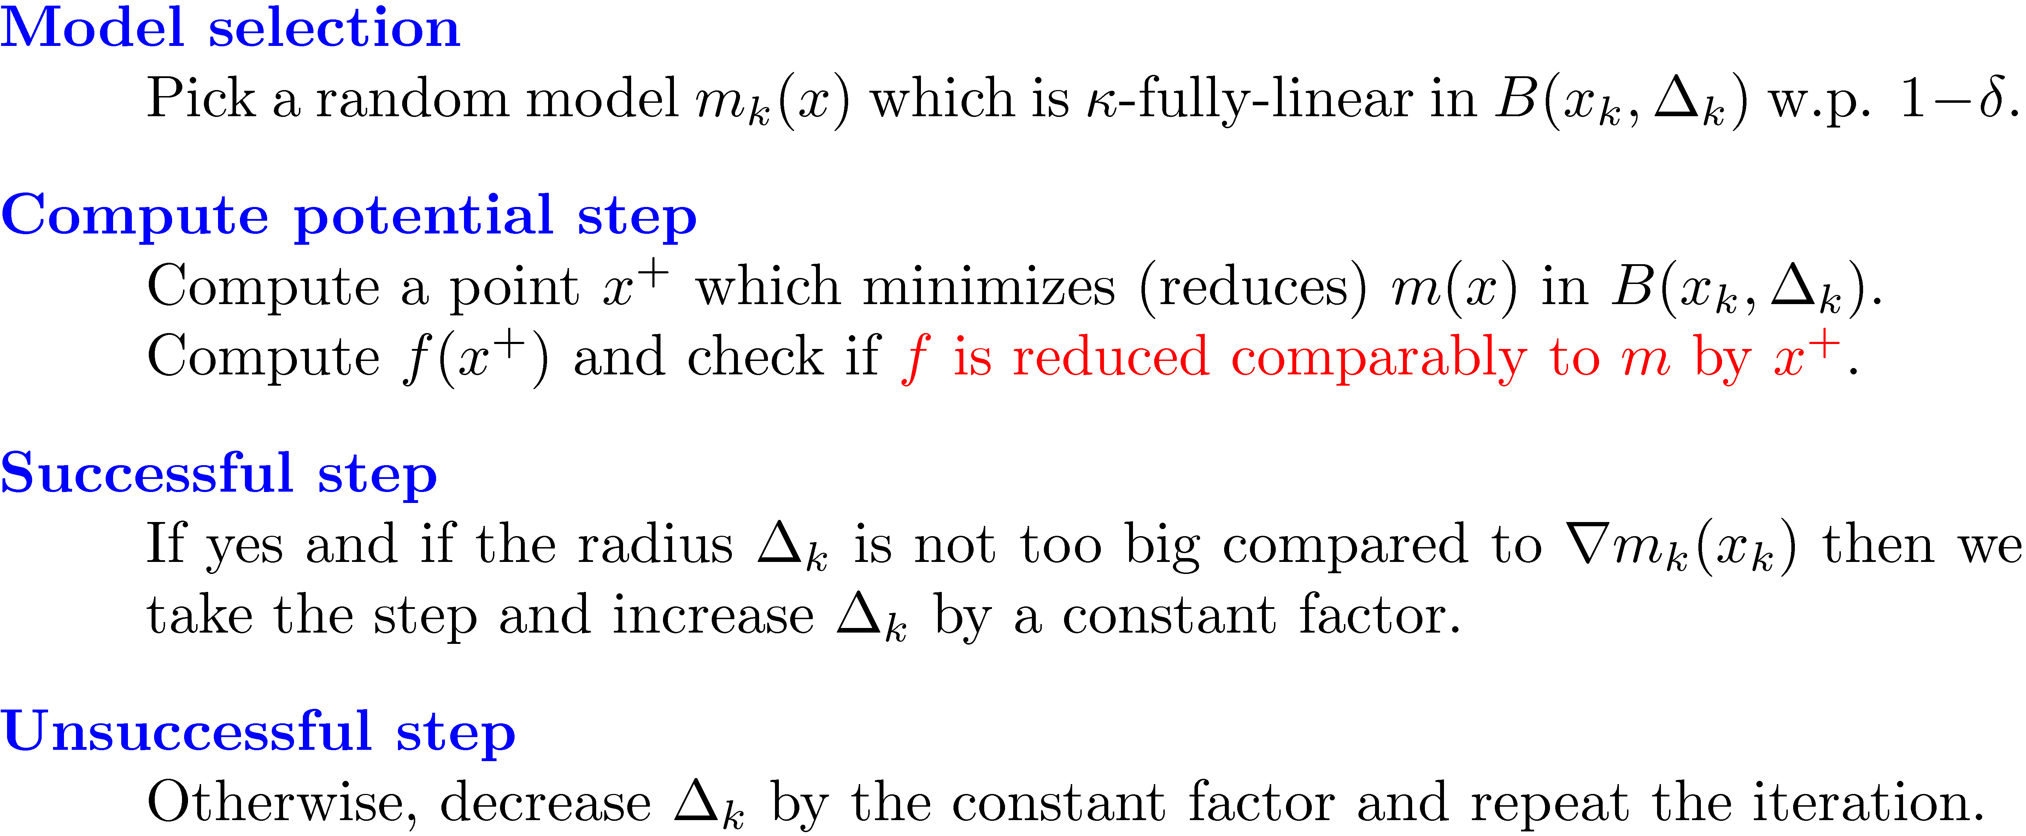
Basic Trust Region Algorithm

Slide 65
Convergence results for the basic TR framework
If models are fully linear with prob. 1-± > 0.5
then with probability one lim ||r f(x_{k})|| =0
If models are fully quadratic w. p. 1-± > 0.5
then with probability one
liminf max {||r f(x_{k})||, ¸_{min}(r²f(x_{k}))}=0
For lim result ± need to decrease occasionally
For details see Afonso Bandeira’s talk on Tue
15:15 - 16:45, room: H 3503

Slide 66
Intuition behind the analysis shown through line search ideas

Slide 67
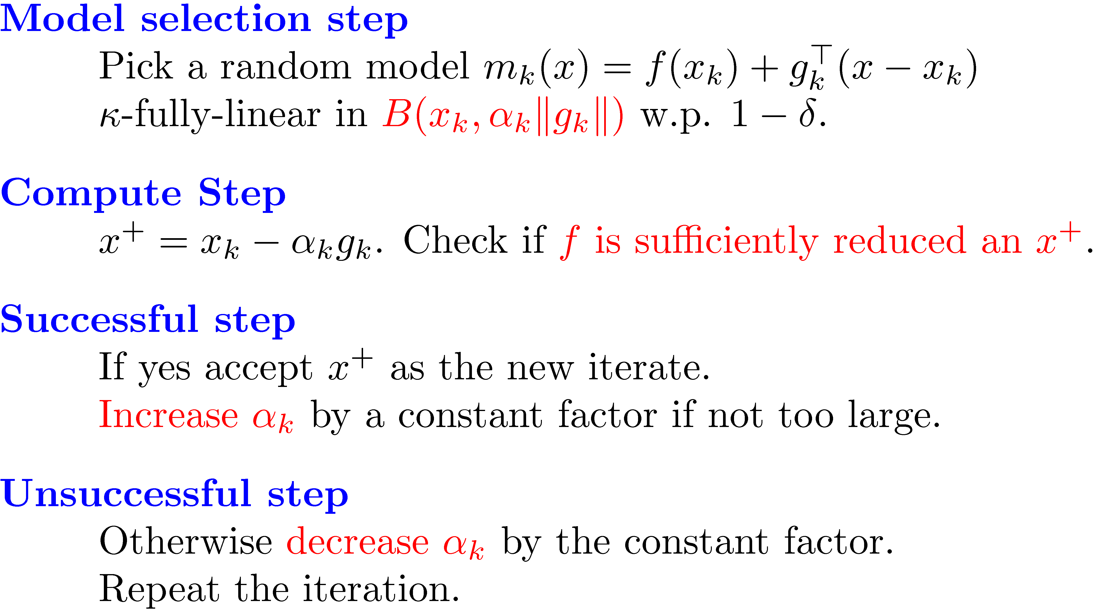
When m(x) is linear ~ line search instead of ¢_{k} use ®_{k} ||r m_{k}(x_{k})||

Slide 68
Random directions vs. random fully linear model gradients
r m(x)
Random direction
rf(x)
R=· ®||r m(x)||

Slide 69
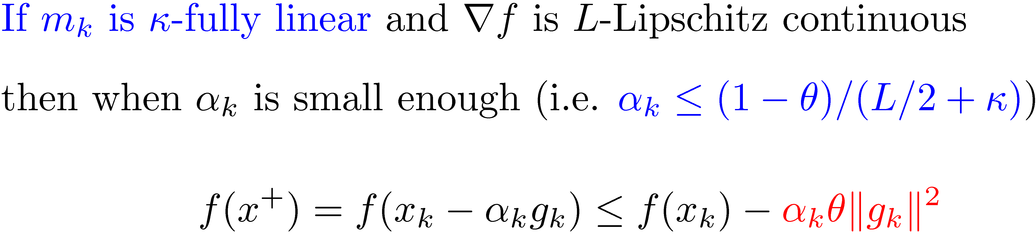
Key observation for line search convergence
Successful step!

Slide 70
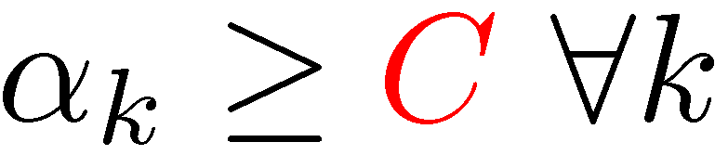
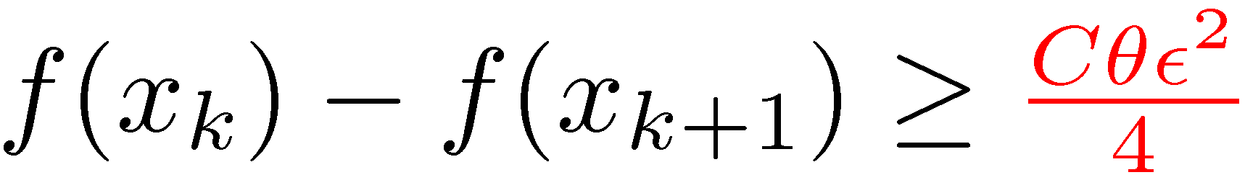
Analysis of line search convergence
C is a constant depending on ·, µ, L, etc
and
Convergence!!

Slide 71
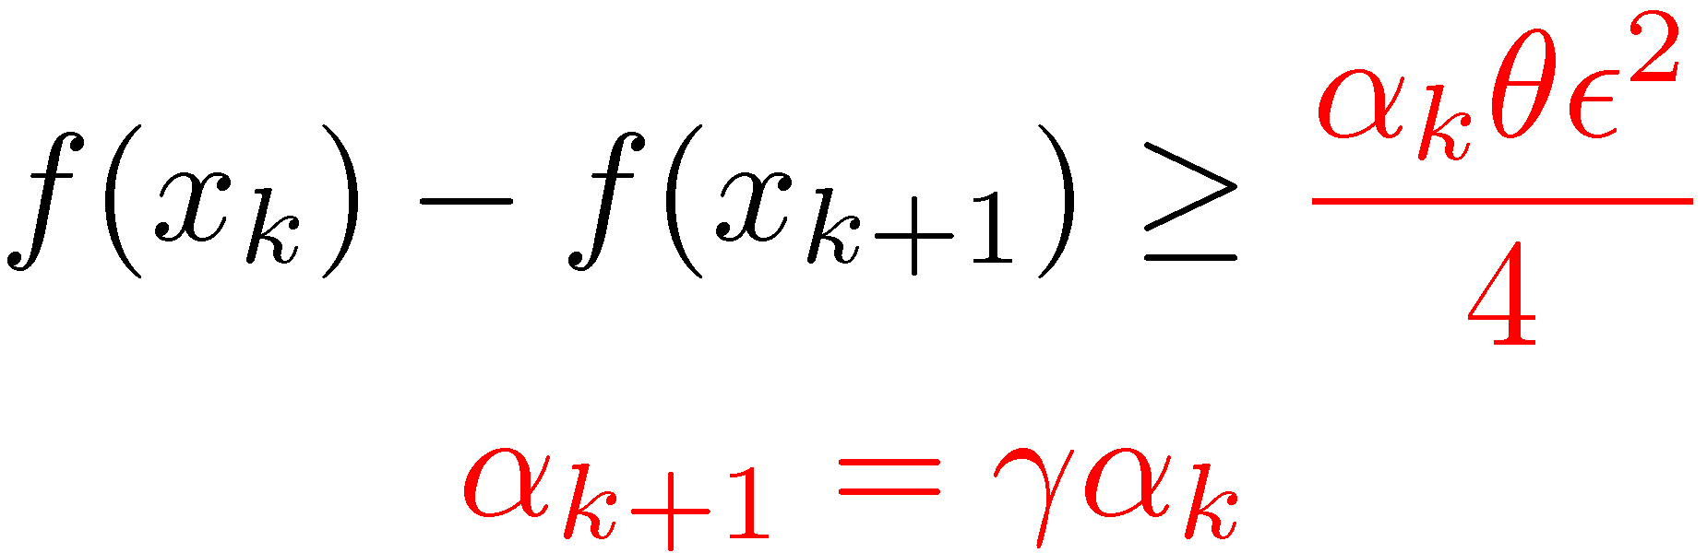
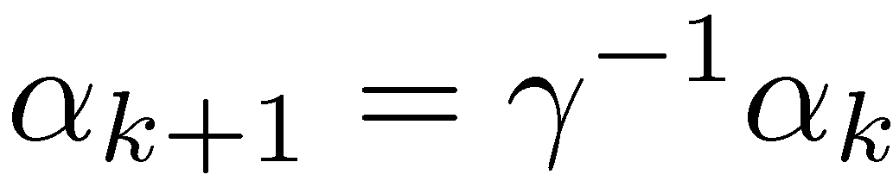
Analysis of line search convergence
w.p. ¸ 1-±
and
w.p. ¸ 1-±
w.p. ¸ 1-±
success
no success
w.p. · ±

Slide 72
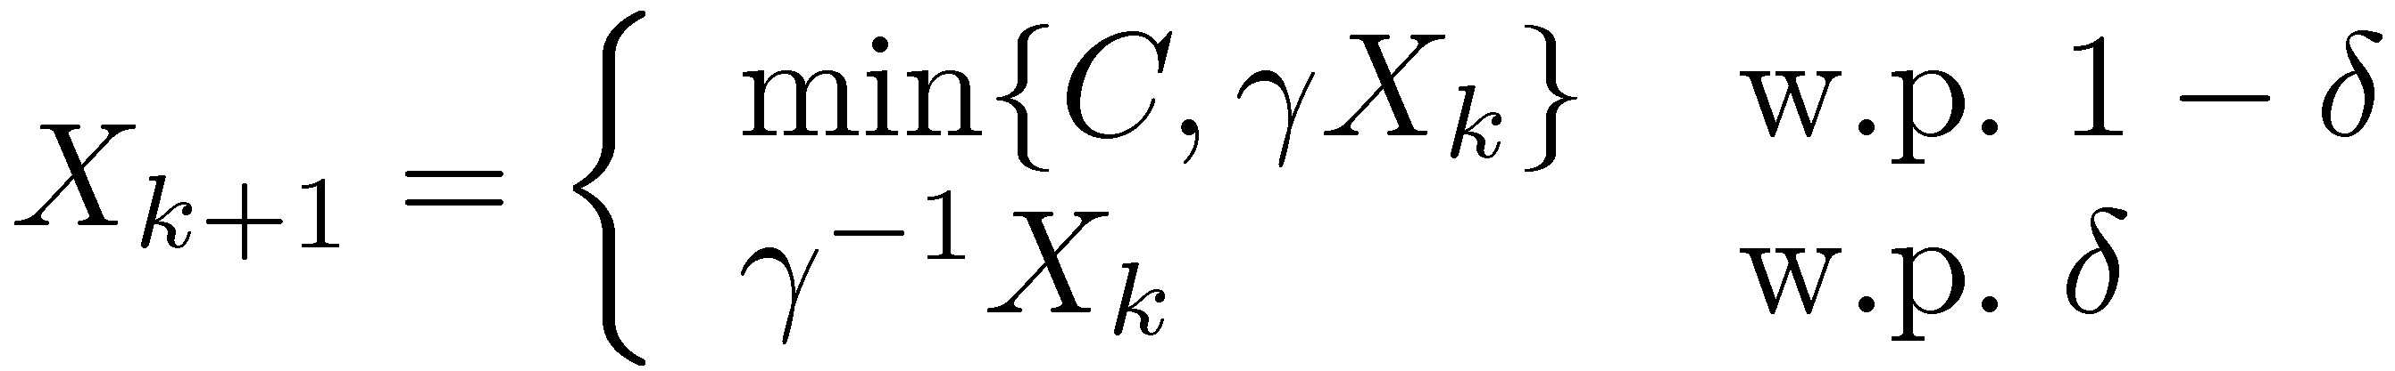
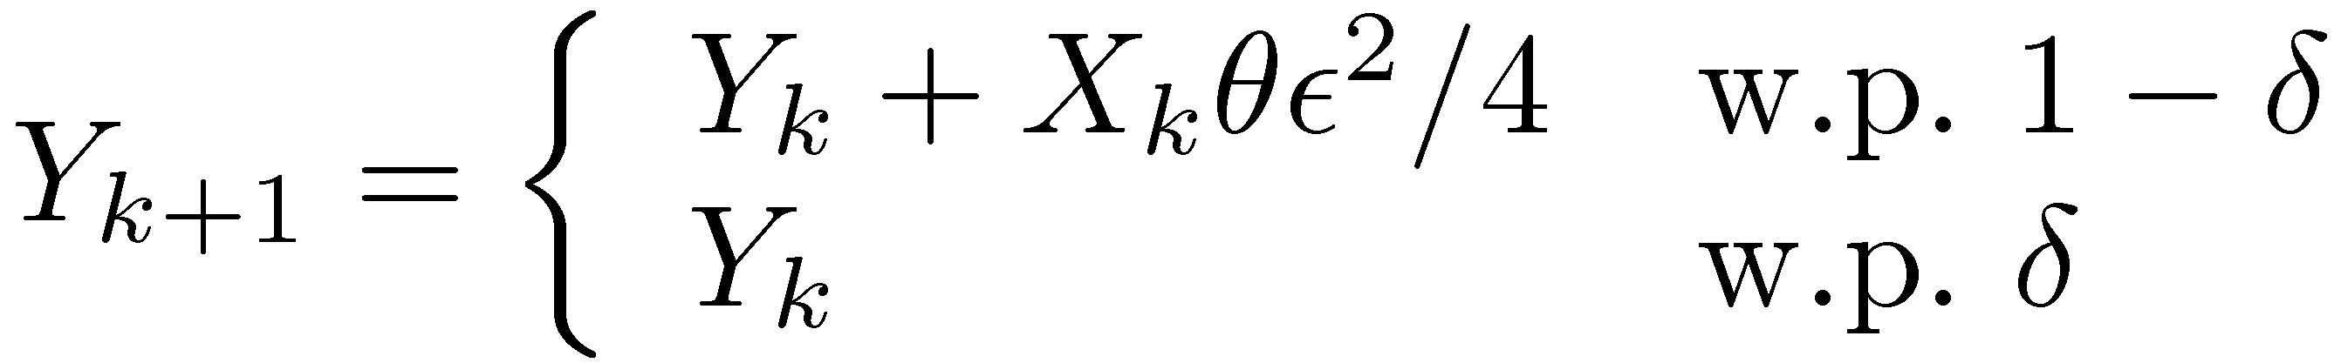
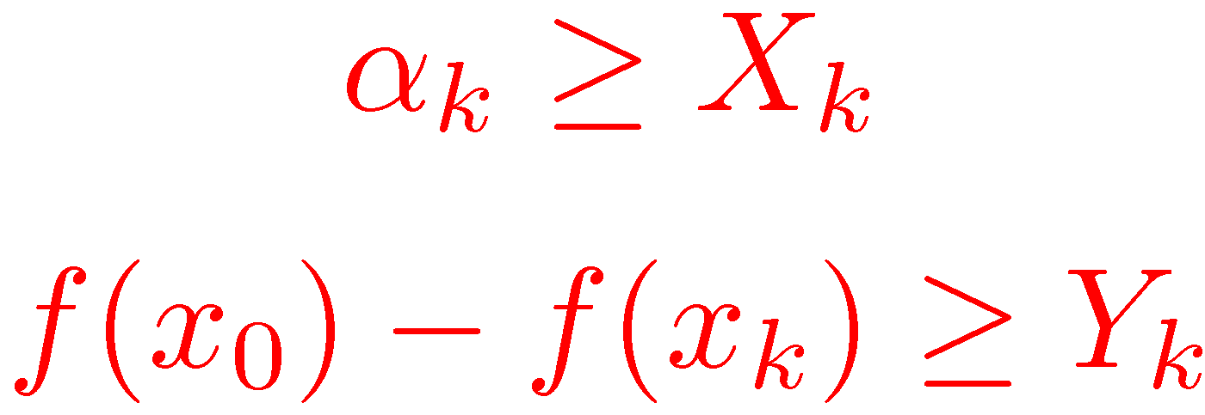
Analysis via martingales
Analyze two stochastic processes: X_{k} and Y_{k}:
We observe that
If random models are independent of the past, then X_{k} and Y_{k} are random walks, otherwise they are submartingales if ± · 1/2.

Slide 73
Analysis via martingales
Analyze two stochastic processes: X_{k} and Y_{k}:
We observe that
X_{k} does not converge to 0 w.p. 1 => algorithm converges
Expectations of Y_{k} and X_{k} will facilitate convergence rates.

Slide 74
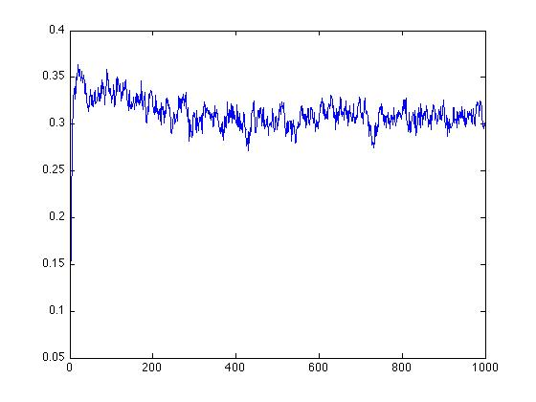
Behavior of X_{k} for °=2, C=1 and ±=0.45
X_{k}
k

Slide 75
Future work
Convergence rates theory based on random models.
Extend algorithmic random model frameworks.
Extending to new types of models.
Recovering different types of function structure.
Efficient implementations.

Slide 76
Thank you!

Slide 77
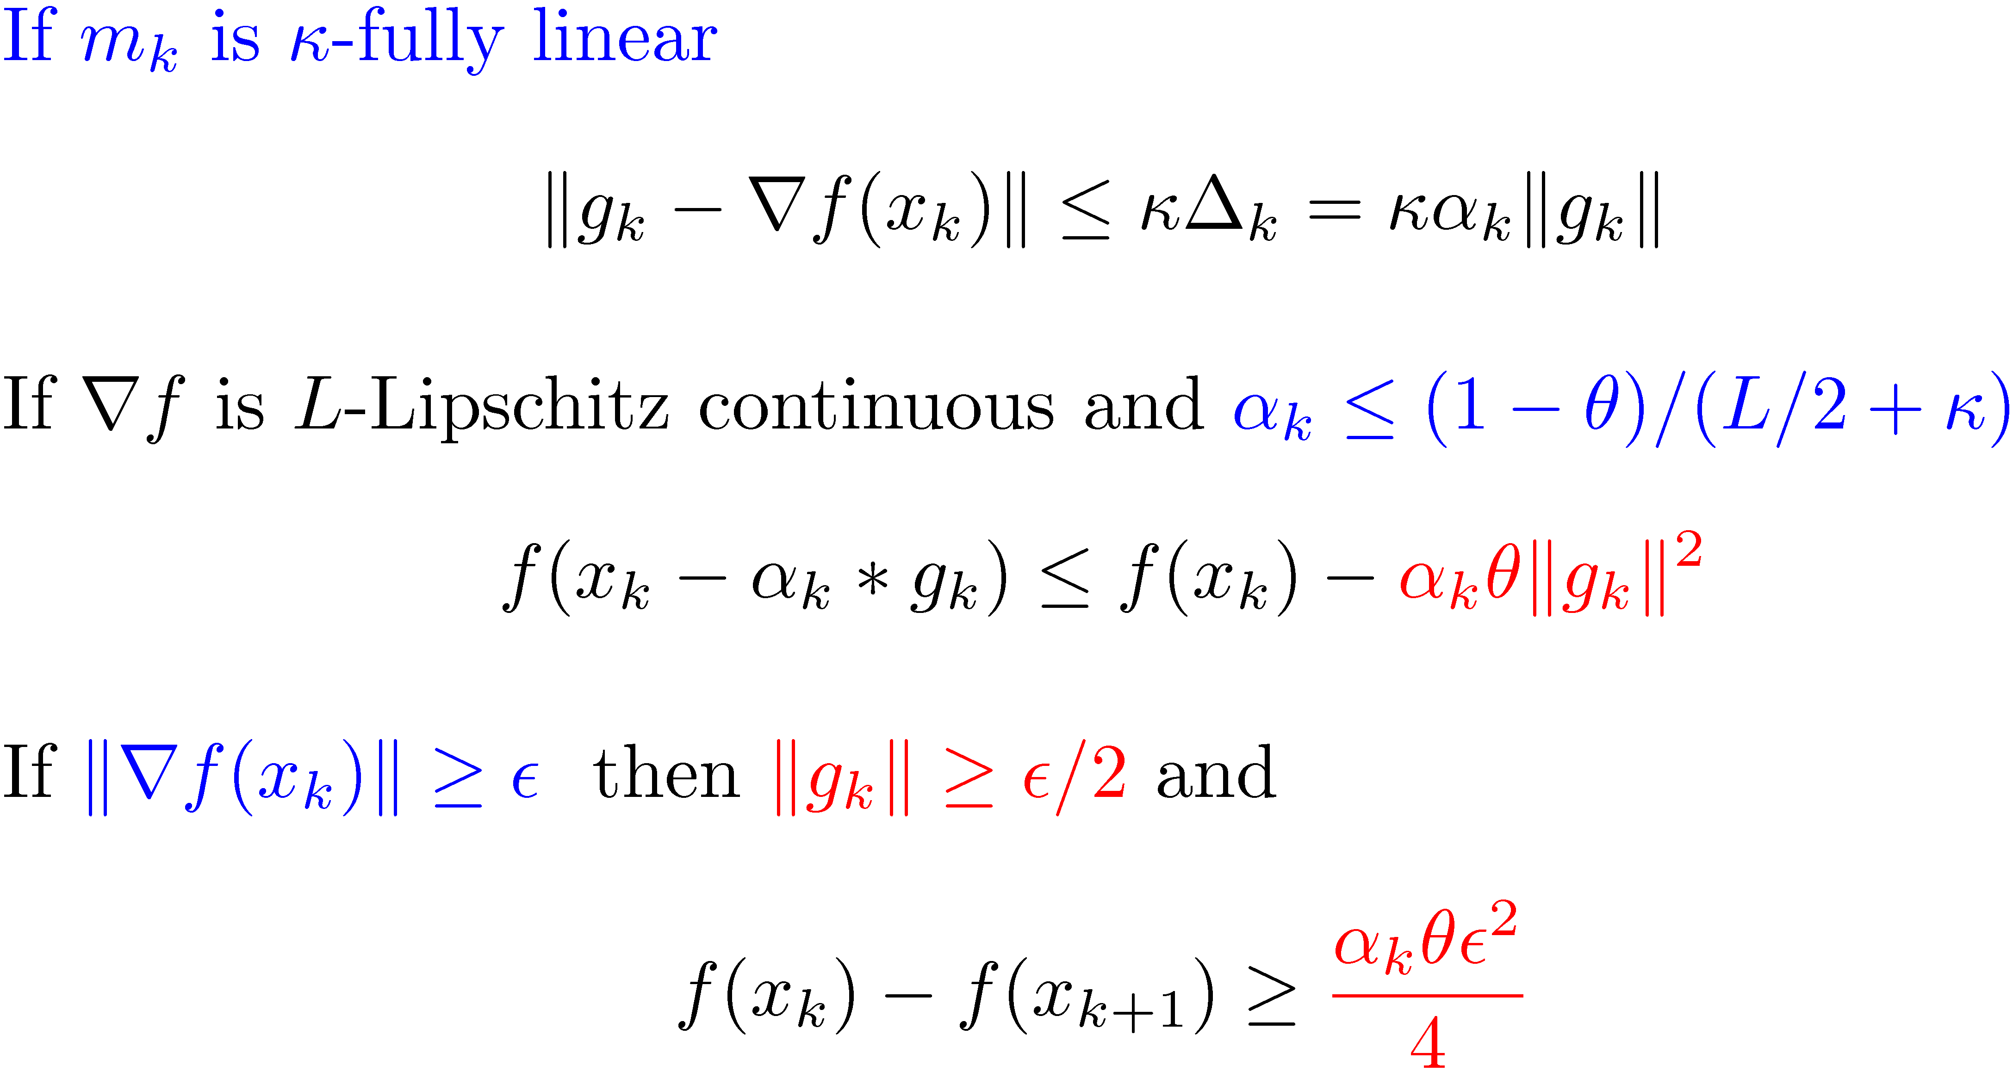
Analysis of line search convergence
Hence only so many line search steps are needed to get a small gradient

Slide 78
Analysis of line search convergence
We assumed that m_{k}(x) is ·-fully-linear every time.

